Slide 1
Population Ecology
and human carrying capacity

Slide 2
Population Ecology
Population ecology studies organisms from the point of view of the size and structure of their populations
  Study the environment by measuring certain properties
    Size
    Density
    Patterns of dispersion
    Demographic
    Growth
    Limiting factors

Slide 3
Definition
A population is an ecological sense is a group of organisms, of the same species, which roughly occupy the same geographical area at the same time

Slide 4
4 things that can affect the size of populations
Birth rate
  Rate at which new members are being born
Death rate
  Rate at which members are dying
Immigration
  Rate at which new members are entering the population
Emigration
  Rate at which members are leaving the population

Slide 5
Population growth
Population growth occurs when the combination of birth rate and immigration exceeds (faster than) death rate and emigration
https://www.census.gov/popclock/

Slide 6
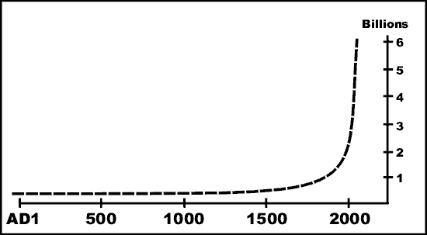
Population growth
Two types of population graphs:
  Exponential growth (J-curve)

Slide 7
Limiting factors
In general, organisms will reproduce as much as they possibly can!
However, a population does not grow indefinitely. At some point, the population stops growing and declines as a result of one or more limiting factors
A limiting factor is a resource or environmental condition that limits a population’s growth, i.e. reduces the size or distribution of a population
Over time, there is a dynamic balance between population potential (i.e. reproduction) and limiting factors that causes population sizes to fluctuate.

Slide 8
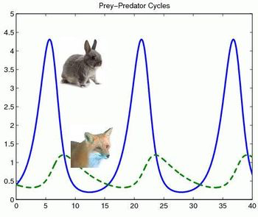

Slide 9
Carrying Capacity
Limiting factors for populations are usually resources (e.g. food, water, habitat), and there is a finite amount of these resources in any environment.
Carrying capacity = the number of organisms the environment can support over time
From your Unit Guide:
Carrying capacity refers to the number of organisms that can live sustainably in a particular environment without destroying its resources.

Slide 10
Carrying Capacity
A population can temporarily rise above or fall below its carrying capacity.
If there are not enough resources, organisms might migrate, reproduce less, or die.
Move, change, or die!
Populations can crash, level off, or fluctuate in response to predators, seasons, etc.

Slide 11
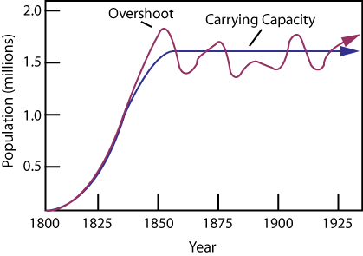
Populations sizes often fluctuate
Logistic growth (s-curve)
Notes:
How can the population overshoot the carrying capacity? Reference “fluctuate” on word wall – tell Ss they should get to know this word.
What factors could make the population size fluctuate?
Think at two levels - population size and carrying capacity itself can change over time.

Slide 12
Ecosystem Dynamics, Functioning, and Resilience
"A complex set of interactions within an ecosystem can keep its numbers and types of organisms relatively constant over long periods of time under stable conditions.
If a modest biological or physical disturbance to an ecosystem occurs, it may return to its more or less original status (i.e., the system is resilient), as opposed to becoming a very different ecosystem.
Extreme fluctuations in conditions or the size of any population, however, can challenge the functioning of ecosystems in terms of resources and habitat availability.”
Notes:
This is a Disciplinary Core Idea in NGSS!
Could have students get out Stability and Change LG and see how I wrote this in simpler terms.

Slide 13
In other words…
Populations naturally fluctuate, but remain relatively stable (i.e. around the carrying capacity) if the environment doesn’t change too much.
If for some reason, the environment or the population size changes dramatically, then this change can destabilize the system
In these cases, the carrying capacity itself may change indefinitely.

Slide 14
Changes in Carrying Capacity
Extreme changes in resources or conditions can destabilize the system changing organisms’ carrying capacities indefinitely
Examples:
  climate change
  habitat destruction
  invasive species
  natural disaster
  unsustainable use of resources
Notes:
Contrast extreme changes with modest/moderate disturbance - seasonal, etc. Diversity generally allows ecosystems to remain relatively stable over time.
Need some good examples… natural and human (human populations have collapsed more then once due to resource depletion – Easter Island, etc.)
Example of deer in a forest. Fire changes the forest to a different type of habitat for a long time. Human disturbance/destruction, etc.
Overlap with CHIPPO, but changes may or may not be caused by humans

Slide 15
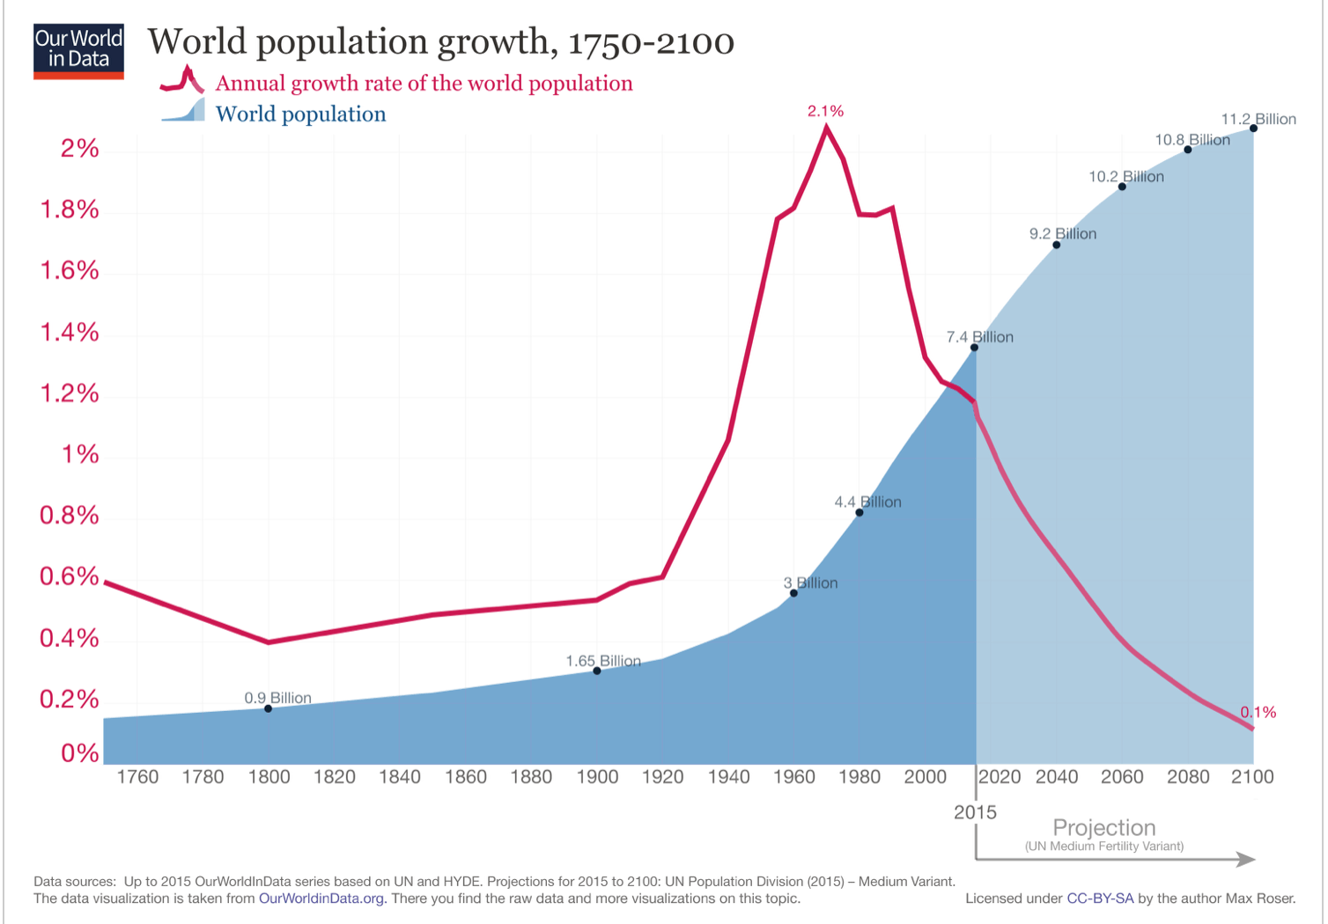
Human Population Growth Graph

Slide 16
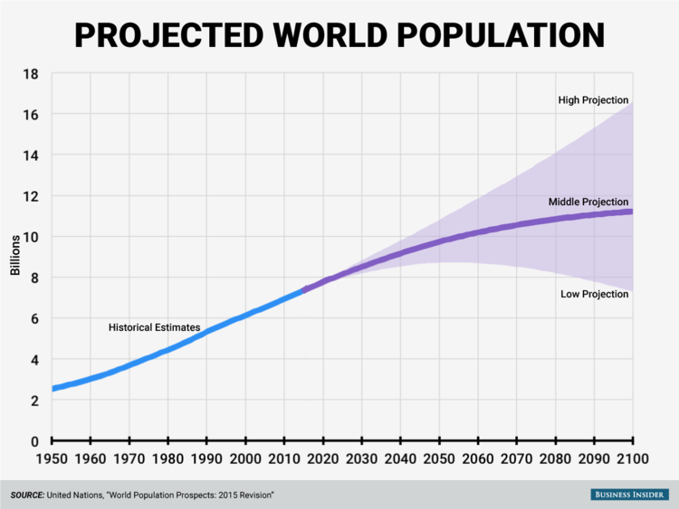
16.8 bil.
11.2 bil.
7.5 bil.
Notes:
World population in Sep. 2024: about 8 billion!
Latest estimates are 10-12 billion people by 2100

Slide 17
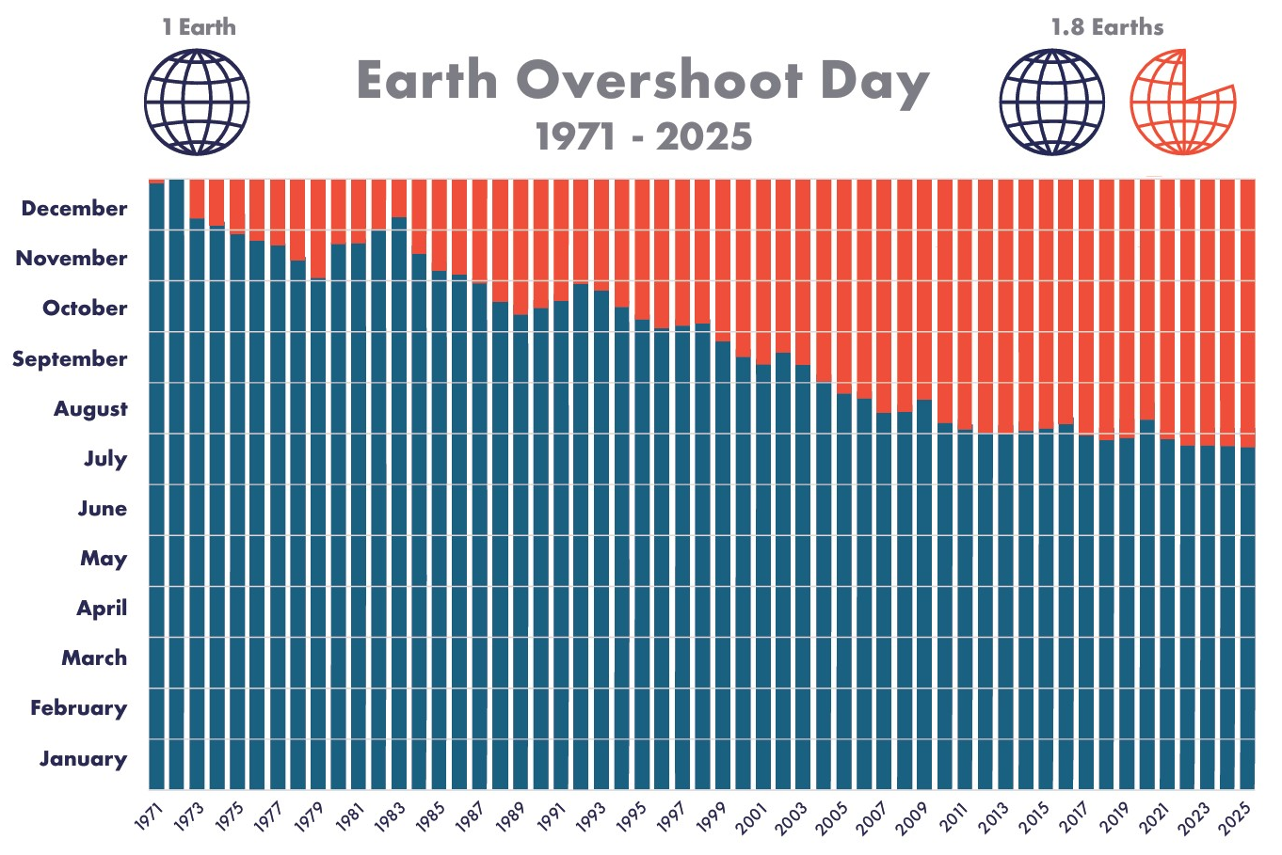
Earth Overshoot Day
Earth Overshoot Day marks the date when humanity’s demand for ecological resources and services in a given year exceeds what Earth can regenerate in that year
Kind of like exceeding our carrying capacity
Notes:
Compare to money: If I spend most/all my money before end of month, I could borrow, steal, use up my savings, or learn to live on less!
#Movethedate!

Slide 18
Earth Overshoot Day
Where are we getting the resources that we use after Earth Overshoot Day?
We are borrowing resources from
  the past (using up “old” resources that took many thousands of years to accumulate, and won’t be renewed for eons, if ever)
    Fossil fuels (coal, oil, natural gas)
    Water (groundwater aquifers)
    Old growth forests
  the present
    decreasing resources available to other organisms 🡪 loss of biodiversity
    people who don’t have enough to maintain a decent quality of life
  the future – YOURS!
Notes:
Compare to money: If I spend most/all my money before end of month, I could borrow, steal, use up my savings, or learn to live on less!
#Movethedate!

Slide 19
Human Carrying Capacity
Humans’ carrying capacity on Earth depends on the quality of life that we expect. Explain.
  Is there some minimum acceptable quality of life that is acceptable / ethical? Who decides?
  Does a higher quality of life necessarily require more resources?
Can humans increase/decrease our carrying capacity? How? For how long?
Carrying capacity is all about RESOURCES (relative to the population) – how many resources are available and how we use them.
Notes:
Let Ss discuss each prompt first for better answers.
What kinds of things influence the size of the carrying capacity? availability of resources, distribution, and importantly for humans, quality of life. if all we expect is to just feed everyone the minimum and pack them closely together in almost any conditions, our carrying capacity is probably 25 billion, but if everyone has to have a 4-bedroom home, an acre of land, a great job, a great education, all organic produce, etc, then we’ve already exceeded the ability to provide that for all people.
Why do scientific estimates of the carrying capacity of the earth for humans vary? It depends on the assumptions the scientist is making about quality of life when they make the estimate. Some people feel we have already exceeded the ethically acceptable carrying capacity because there is famine, disease, war…
How can humans increase/decrease their carrying capacity? Changes in efficiency/use of resources, along with enough equality that everyone can work together to make smart decisions. Note: Improvements in health care, sanitation, etc. increase lifespan/population/quality of life; they do NOT increase carrying capacity!

